Slide 1



Maximizing Play Success in the NFL
The Impact of Down, Distance, Formation and Field Position
Presented By: Skylar Furey

Slide 2
Statistic Definitions
Success Rate: Percentage of plays gaining positive yards
Explosive Rate: Percentage of plays gaining ten or more yards

Slide 3
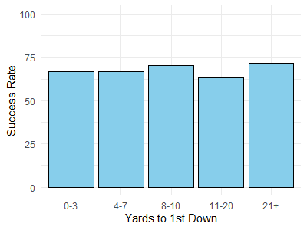
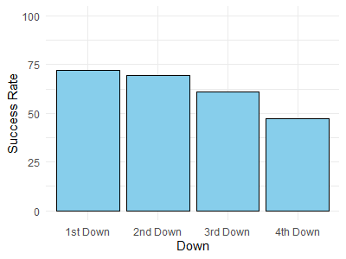
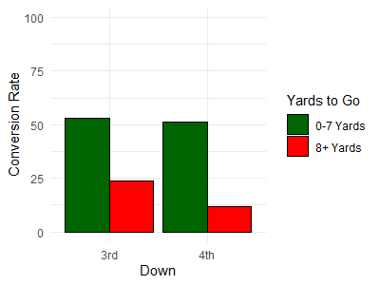
Insights: Down & Distance
Notes:
Design Decisions

Slide 4
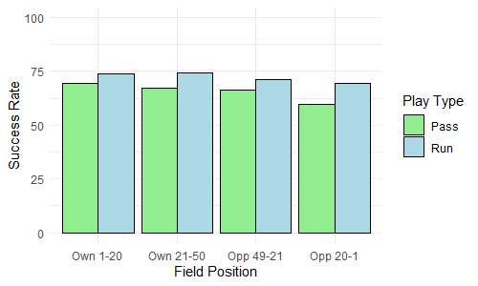
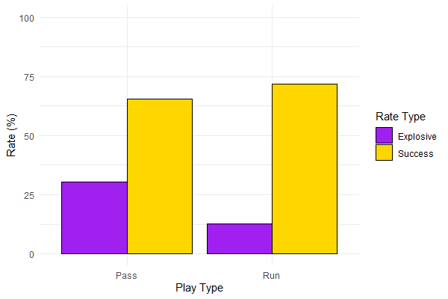
Insights: Field Position & Play Type
Notes:
Design Decisions

Slide 5
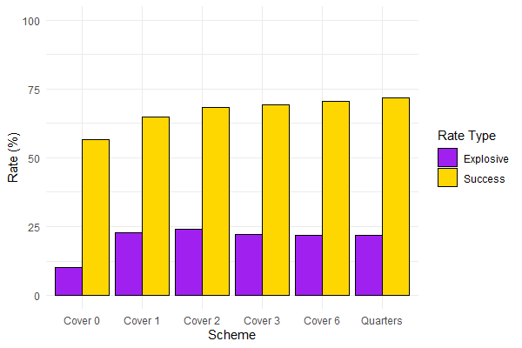
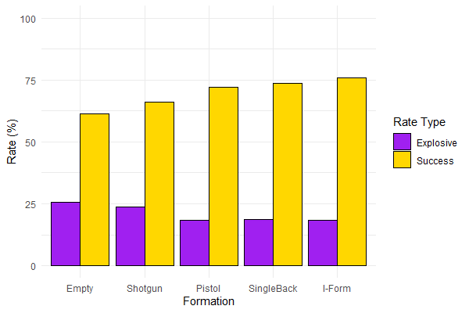
Insights: Offense & Defense
Notes:
Design Decisions

Slide 6
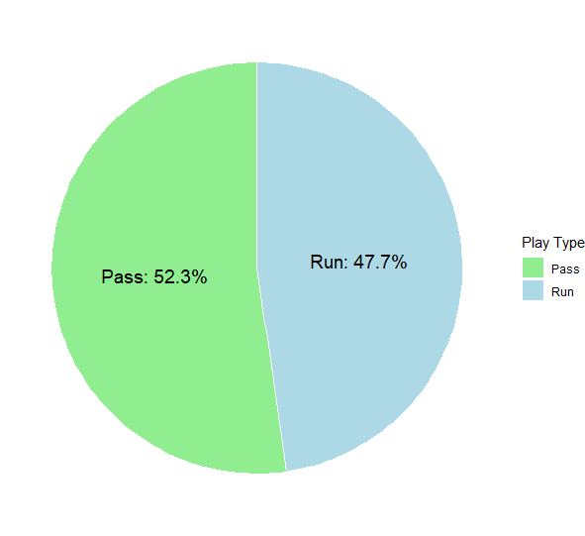
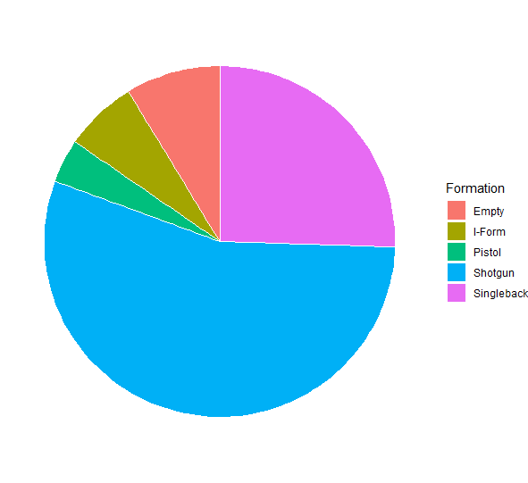
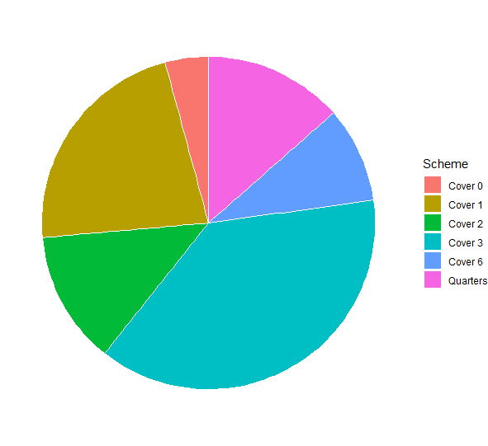
Insights: Usage Rates
Notes:
Design Decisions

